Slide 1
DATA PREPROCESSING TUTORIAL
WITH R
12 May, 2025

Slide 2

WHY DATA CLEANNING
Ensuring Accuracy: Raw clinical data often contains errors, inconsistencies, or missing values. Cleaning helps ensure that the data accurately reflects patient information and clinical measurements.
Improving Data Quality: High-quality data is essential for reliable analysis, robust model building, and valid conclusions. Cleaning removes noise and outliers, ensuring more precise outcomes.
Enhancing Reproducibility: In clinical research, reproducibility is critical. Clean data supports transparent methods, making it easier to replicate findings and validate results.
Facilitating Better Decisions: Clean data provides a solid foundation for statistical analyses and predictive modeling, ultimately aiding in better-informed clinical decisions and improved patient care.
Notes:
Data quality is the qualitative and or quantitative measure of how well our data suits the purpose it is required to serve. These measures are practical templates we can use to assess how suitable the data provided is for our desired purposes. Consider these data quality measures as metrical tests our data must pass to deem it fit for data science processes.
Criteria for data quality
Accuracy: A simple question we can ask to verify accuracy is - is the information contained in the data provisioned correctly in every detail? With data, we are trying to approximate patterns in the real world; accuracy helps define how true these approximations are.
Relevance: Is this information impactful to what our desired end goal is?
Consistency: Is the source of this data verified and can the information contained there be trusted? For example, having a customer who is age 15 but marital status is indicated to be married.
Completeness: Is the data provisioned and comprehensive enough for the desired end goal? This is a common problem associated with missing data and one way to resolve this is by investigating the data source.
Uniformity: Let's assume we have a sales column but not all transactions are made in the same currency. It becomes imperative to convert all the sales values into a single currency and that is what uniformity is about; ensuring that data measures are specified using the same units of measure in all systems.

Slide 3
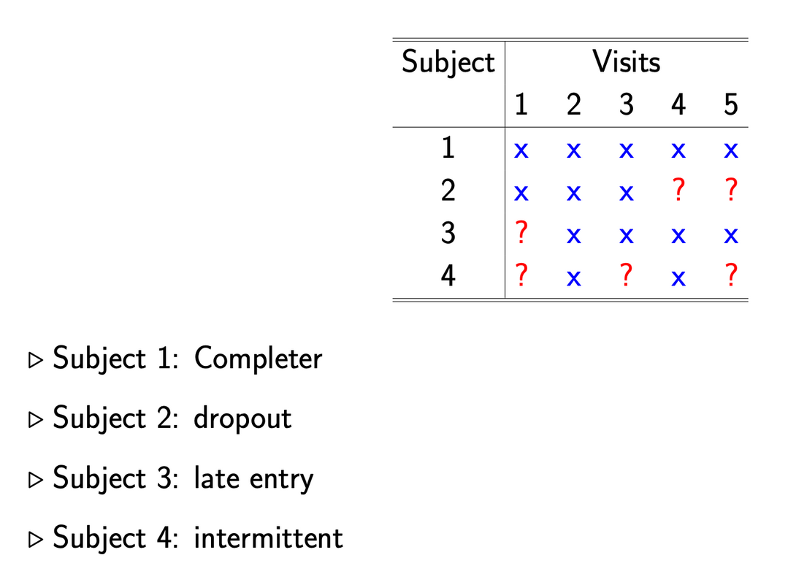
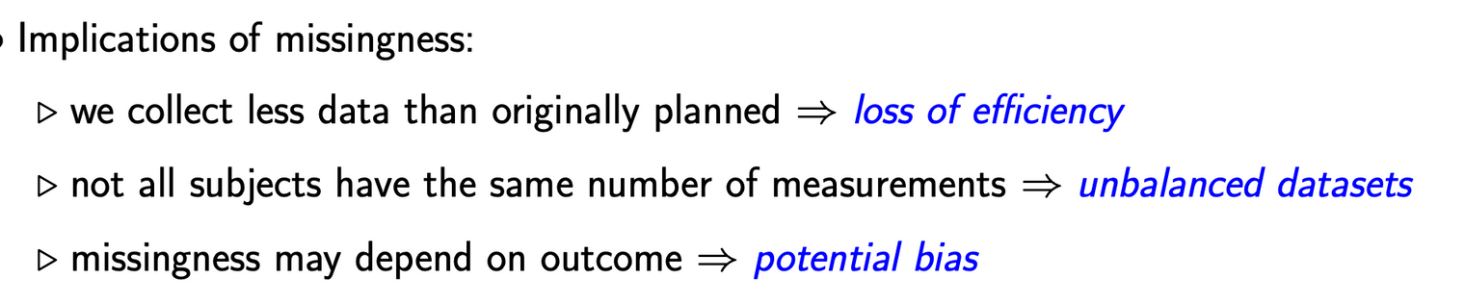

Slide 4
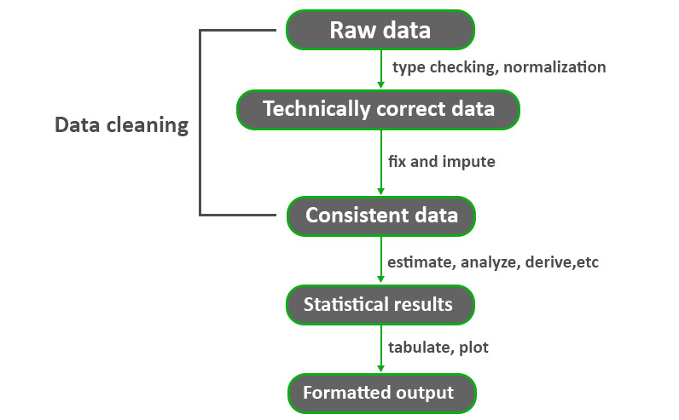
GENERAL DATA ANALYSIS PIPELINE

Slide 5

DATA CLEANING
CLEAN DATA
Remove duplicate rows/values
exchange special characters (e.g. -4, NA, white space)
Convert appropriate data type for analysis
Remove outliers
SPECIAL CHARACTERS
Special characters (e.g. commas in numeric values)
Numeric values stored as text/character data types
Duplicate rows
Misspellings
Inaccuracies
White space
Missing data
Zeros instead of null values vary.

Slide 6
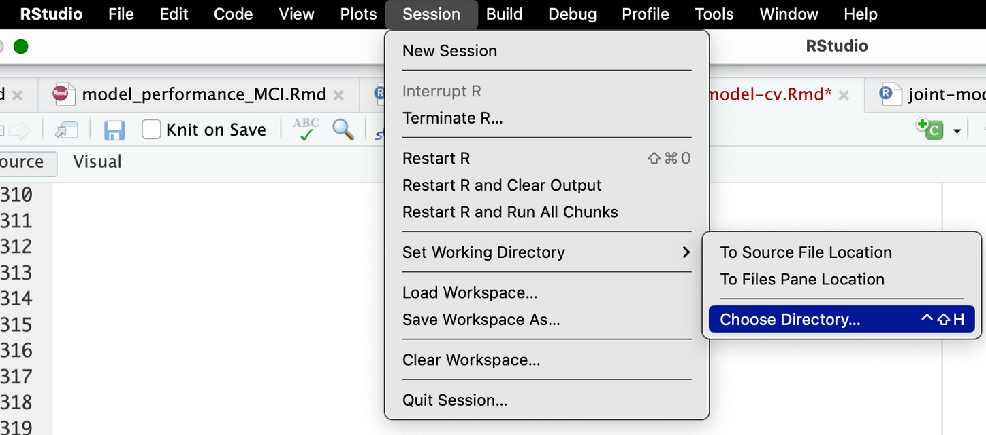
READ DATA - 1
source(path/Desktop/somescript.R)
-> find the directory

Slide 7
READ DATA - 2
load("data.RData")
-> read RData
-> read csv file
read.csv("data.csv")
read.csv("data.csv", skip=1)
-> skip the first row
read.csv("data.csv", row.names = 1)
-> read csv with the first column as row names (index)
read.csv("data.csv", row.names = NULL)
-> read csv with no index column
read.csv("data.csv", na.strings=c("NA", "", " "))
-> read csv with custom NA values
read.csv("data.csv", colClasses = c("numeric","logical","categorical"))
-> read columns as numeric
library(readxl)
read_excel("data.xlsx")
-> read excel file

Slide 8
BASIC R CODE
rm(list = ls())
-> Clears the workspace by removing all objects from the current environment
data(iris)
-> import the sample data
head(df)
-> get top rows for the dataframe
summary(df)
-> get each feature data distribution (i.e. min, max, iqr, NAs)
str(df)
-> get a summary of an object’s structure
class(df)
-> find the class an object belongs to

Slide 9
CHECK FOR MISSINGS
sum(is.na(df))
-> Total count of missing values
mean(is.na(df)) * 100
-> Overall percentage of missing values
apply(df, 1, function(x) mean(is.na(x)) * 100)
-> Percentage of missing values per row
apply(df, 2, function(x) mean(is.na(x)) * 100)
-> Percentage of missing values per column
names(df)[sapply(df, function(x) mean(is.na(x))) > thres]
(i.e. thres = 0.2)
-> Column names with >20% missing values
df <- df[apply(df, 1, function(x) mean(is.na(x))) <= 0.2, ]
-> Remove rows with >20% missing
df <- df[, sapply(df, function(x) mean(is.na(x))) <= 0.2]
-> Remove columns with >20% missing

Slide 10
IMPUTATION - 1
df$col_mean[is.na(df$col_mean)] <- mean(df$col_mean, na.rm = TRUE)
-> Impute missing values with mean for certain columns
df$col_median[is.na(df$col_median)] <- median(df$col_median, na.rm = TRUE)
-> Impute missing values with median for certain columns
na_idx <- is.na(df$col_norm)
df$col_norm[na_idx] <- rnorm(sum(na_idx), mean = 0, sd = sd(df$col_norm, na.rm = TRUE))
-> Impute a numeric column with random values drawn from a normal distribution centered at 0
na_idx <- is.na(df$cat)
df$cat[na_idx] <- sample(na.omit(df$cat), sum(na_idx), replace = TRUE)
-> Impute a categorical column by randomly choosing from non-missing values

Slide 11
IMPUTATION - 2
library(Hmisc)
df[ , sapply(df, is.numeric)] <- lapply(df[ , sapply(df, is.numeric)], function(x) impute(x, fun = mean))
-> For all numeric columns, impute missing values with the column's mean
library(mice);
df_mice <- complete(mice(df, m = 5, method = "pmm", seed = 123))
Multivariate Imputation by Chained Equations (MICE)
Iteratively fits a model for each variable with missing values using the other variables as predictors.
Can impute both continuous (numeric) and categorical data (binary, nominal, ordinal). Predictive Mean Matching (pmm) for continuous data and logistic regression for binary or multinomial logistic regression for categorical data
library(missranger)
df_missranger <- missRanger(df, pmm.k = 3, num.trees = 100)
Based on the Random Forest algorithm
Handles mixed-type data including numeric and categorical variables.

Slide 12
DATA TRANSFORMATION
df$var <- as.logical(df$var)
-> to Boolean value (i.e. TRUE, FALSE)
df$var <- as.numeric(df$var)
-> to integers or floating point numbers (i.e. 0,1,2, 0.5)
df$var <- as.character(df$var)
-> to character strings (i.e. ‘0’, ‘1’)
df$var <- as.factor(df$var)
-> to character strings with present levels (i.e. levels: ‘0’, ‘1’)

Slide 13
NACC EXAMPLES

Slide 14
STEP1- UNDERSTANDING THE DATA
1.load the dataset
caa_df<- read.csv("../raw_data/investigator_ftldlbd_nacc66.csv", check.names = FALSE)
2.understant the key variables
unique participant ID (NACCID)
-> need to convert to the numeric (i.e. NACC002909 -> 2909)
head(caa_df$NACCID)
[1] "NACC002909" "NACC002909" "NACC003487" "NACC004352" "NACC004687" "NACC007213"
caa_df$NACCID <- as.integer(gsub("NACC", "", caa_df$NACCID))
head(caa_df$NACCID)
[1] 2909 2909 3487 4352 4687 7213
event/target/focus of interest
-> need to convert to the numeric (i.e. NACC002909 -> 2909)

Slide 15
THANK YOU
12 May, 2025

